Slide 2
Objectives
Explain operators and their types in JavaScript
Explain regular expressions in JavaScript
Explain decision-making statements in JavaScript

Slide 3
Basics of Operators 1-2
An operation is an action performed on one or more values stored in variables.
The specified action either changes the value of the variable or generates a new value.
An operation requires minimum one symbol and some value.
Symbol is called an operator and it specifies the type of action to be performed on the value.
Value or variable on which the operation is performed is called an operand.
Unary operators - Operates on a single operand.
Binary operators - Operates on two operands.
Ternary operators - Operates on three operands.

Slide 4
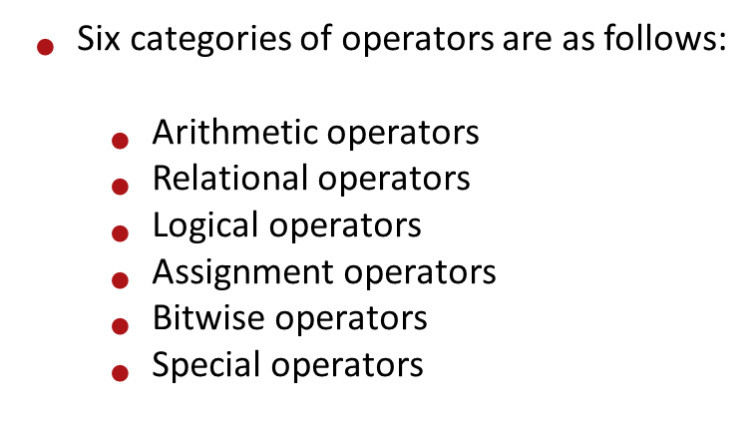
Basics of Operators 2-2

Slide 5
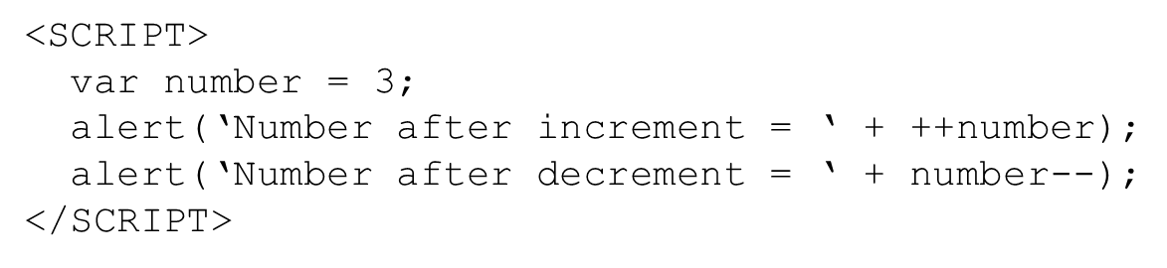
Arithmetic / Increment and Decrement Operators
^{Arithmetic Operators:}
Are binary operators:
+ (addition) – (subtraction) * (multiplication) / (divsiion) % (modulo)
Allow to perform computations on numeric and string values on two operands.
Increment – Decrement Operators:
are unary operators.
can be placed either before (pre-increment or pre-decrement) or after the operand (post-increment or post-decrement.).
^{Example.}

Slide 6
Relational & Logical Operators
Relational Operators are binary operators that make a comparison between two operands.
They are : == != === !== > >= < <=
After making a comparison, they return a boolean value: true or false.
Expression consisting of a relational operator is called as the relational expression or conditional expression.
Logical operators are operators that perform logical operations: && (and), || (or ) , ! (not)
They belong to the category of relational operators, as they return a boolean value.

Slide 7
Assignment Operators
assign the value of the right side operand to the operand on the left side by using the equal to operator (=).
Simple assignment operator is the ‘=’ operator which is used to assign a value or result of an expression to a variable.
Compound assignment operator is formed by combining the simple assignment operator with the arithmetic operators.
Expressions | Description | Result
numOne += 6; | numOne = numOne + 6 | numOne = 12
numOne -= 6; | numOne = numOne – 6 | numOne = 0
numOne *= 6; | numOne = numOne * 6 | numOne = 36
numOne %= 6; | numOne = numOne % 6 | numOne = 0
numOne /= 6; | numOne = numOne / 6 | numOne = 1

Slide 8
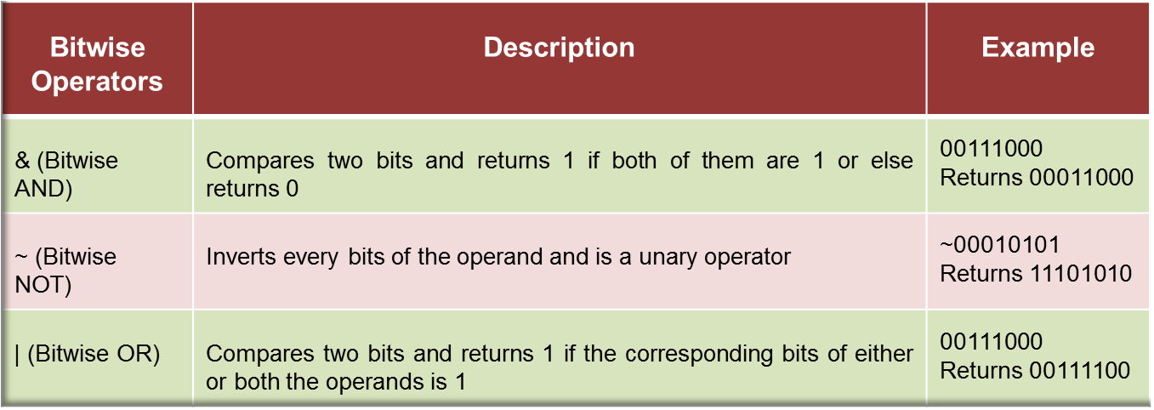
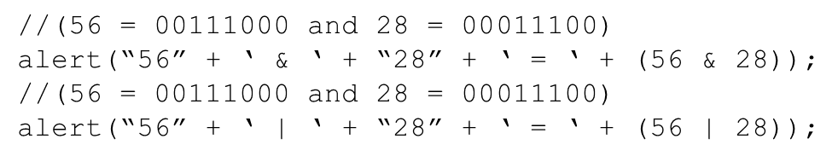
Bitwise Operators
Represent their operands in bits (zeros and ones) and perform operations on them.
They return standard decimal values.

Slide 9
Special Operators 1-2
There are some operators which do not belong to any of the categories of JavaScript operators.
Following table lists the special operators in JavaScript.
Special Operators | Description
, (comma) | Combines multiple expressions into a single expression, operates on them in the left to right order and returns the value of the expression on the right.
?: (conditional) | Operates on three operands where the result depends on a condition. It is also called as ternary operator and has the form condition, ? value1:value2. If the condition is true, the operator obtains value1 or else obtains value2.
typeof | Returns a string that indicates the type of the operand. The operand can be a string, variable, keyword, or an object.

Slide 10
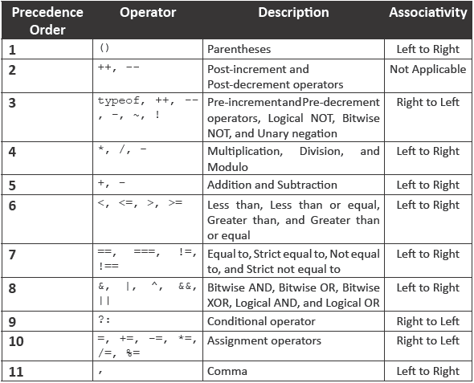
Operator Precedence
Following table lists the precedence of the operators from the highest to the lowest and their associativity.

Slide 11
Regular Expressions
Is a pattern that is composed of set of strings, which is to be matched to a particular textual content.
Allow handling of textual data effectively when searching and replacing strings.
Allows handling of complex manipulation and validation, which could otherwise be implemented through lengthy scripts.
There are two ways to create regular expressions:
Literal Syntax:
RegExp() Constructor:
Is useful when the Web page designer does not know the pattern at the time of scripting.
Allows specifying a fixed pattern, which is stored in a variable
Method dynamically constructs a regular expression when the script is executed.
Syntax : var variable_name = /regular_expression_pattern/;
Syntax : var variable_name = new RegExp(“regular_expression_pattern”,“flag”);
Refers to a static value

Slide 12
RegExp Methods and Properties
test(string) - Tests a string for matching a pattern and returns a Boolean value that indicates whether the pattern exists or not in the string. The method is commonly used for validation.
exec(string) - Executes a string to search the matching pattern within it. The method returns a null value, if pattern is not found. In case of multiple matches, it returns the matched result set.
^{Attributes} | ^{Description}
$n | Represents the number from 1 to 9. It stores the recently handled parts of a parenthesized pattern of a regular expression.
global | Indicates whether the given regular expression contain a g flag. The g flag specifies that all the occurrences of a pattern will be searched globally, instead of just searching for the first occurrence.
IgnoreCase | Indicates whether the given regular expression contains an i flag.
lastndex | Stores the location of the starting character of the last match found in the string. In case of no match, the value of the property is -1.
asc | Stores the copy of the pattern.

Slide 13
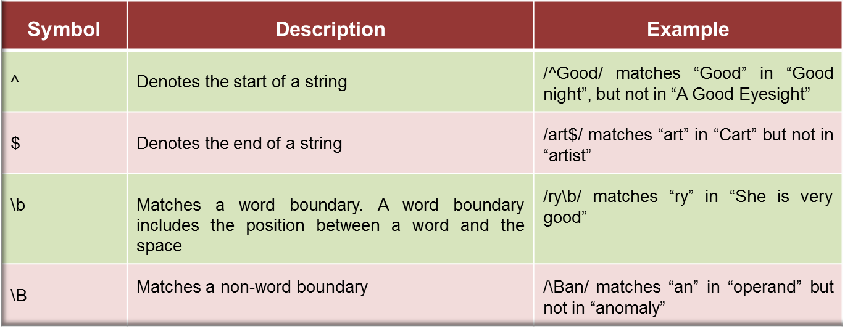
Categories of Pattern Matching
Different categories of pattern matching character that are required to create a regular expression pattern are as follows:
Position Matching
Character Classes
Repetition
Alternation and Grouping
Back Reference

Slide 14
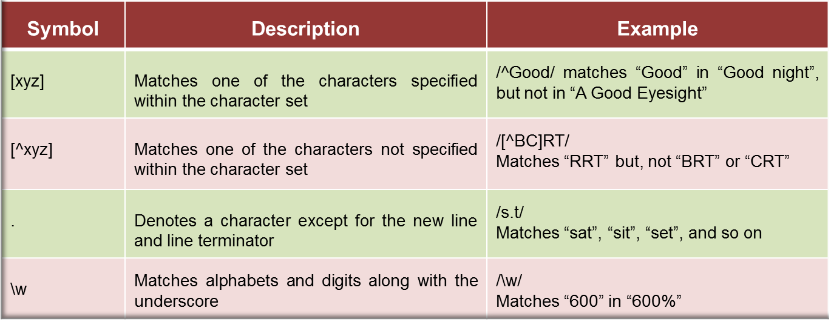
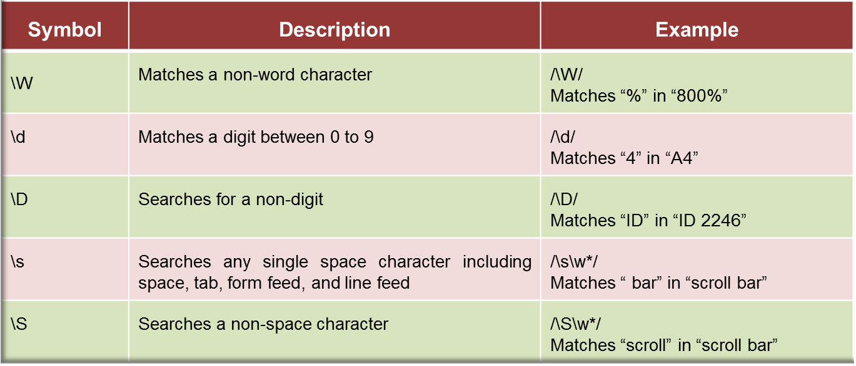
Character Classes

Slide 15
Repetition
Characters or symbols in this category allow matching characters that reappear frequently in a string.
Following table lists the various repetition matching symbols.
^{Symbol} | ^{Description} | ^{Example}
{x} | Matches x number of occurrences of a regular expression | /\d{6}/ Matches exactly 6 digits”
{x, } | Matches either x or additional number of occurrences of a regular expression | /\s{4,}/ Matches minimum 4 whitespace characters
{x,y} | Matches minimum x to maximum y occurrences of a regular expression | /\d{6,8}/ Matches minimum 6 to maximum 8 digits
? | Matches minimum zero to maximum one occurrences of a regular expression | /l\s?m/ Matches “lm” or “l m”
* | Matches minimum zero to multiple occurrences of a regular expression | /im*/ Matches “i” in “Ice” and “imm” in “immaculate”, but nothing in “good”

Slide 16
Alternation and Grouping
Characters or symbols in this category allow grouping characters as an individual entity or adding the ‘OR’ logic for pattern matching.
Following table lists the various alternation and grouping character symbols.
^{Symbol} | ^{Description} | ^{Example}
() | Organizes characters together in a group to specify a set of characters in a string | /(xyz)+(uvw)/ Matches one or more number of occurrences of “xyz” followed by one occurrence of “uvw”
| | Combines sets of characters into a single regular expression and then matches any of the character set | /(xy)|(uv)|(st)/ Matches “xy” or “uv” or “st”

Slide 17
Back References
Characters or symbols in this category allow grouping characters as an individual entity or adding the ‘OR’ logic for pattern matching.
Following table lists the various alternation and grouping character symbols.
^{Symbol} | ^{Description} | ^{Example}
()\n | Matches a parenthesized set within the pattern, where n is the number of the parenthesized set to the left | /(\w+)\s+\1/ Matches any word occurring twice in a line, such as “hello hello”. The \1 specifies that the word following the space should match the string, which already matched the pattern in the parentheses to the left of the pattern. To refer to more than one set of parentheses in the pattern, you would use \2 or \3 to match the appropriate parenthesized clauses to the left. You can have maximum 9 back references in the pattern

Slide 18
Decision-making Statements
Statements are referred to as a logical collection of variables, operators, and keywords that perform a specific action to fulfill a required task.
Statements help you build a logical flow of the script.
In JavaScript, a statement ends with a semicolon.
The related statements are grouped together are referred to as block of code and are enclosed in curly braces.
Decision-making statements allow implementing logical decisions for executing different blocks to obtain the desired output.

Slide 19
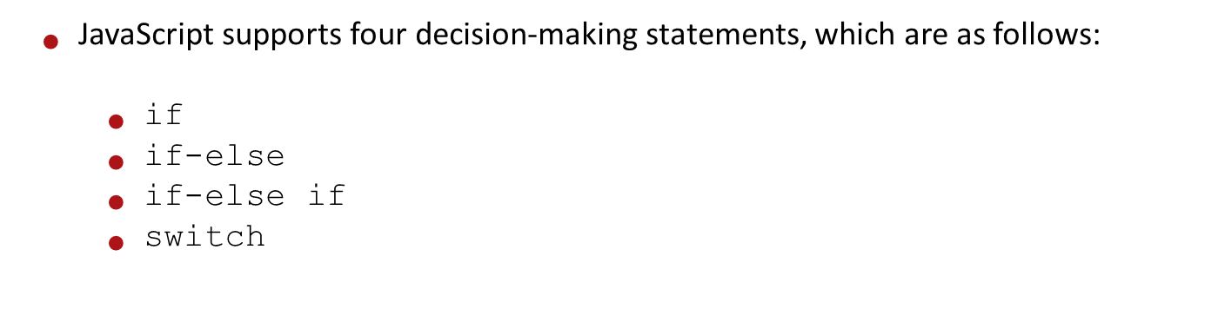
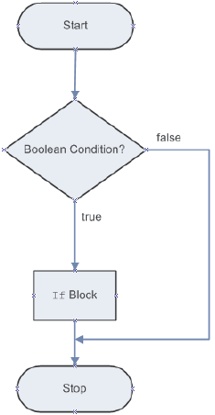
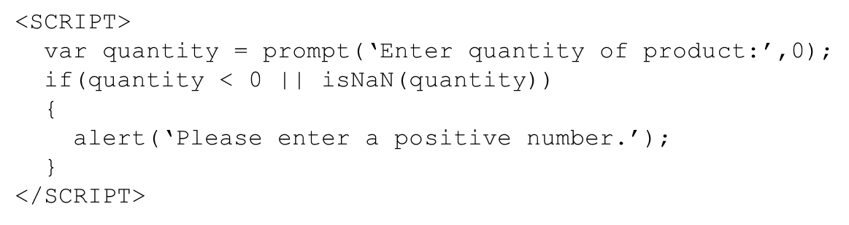
Decision-making Statements
^{If statement}

Slide 20
if-else Statement
The Code Snippet demonstrates the use of if-else statement.
<SCRIPT>
var firstNumber = prompt(‘Enter first number:’,0);
var secondNumber = prompt(‘Enter second number’,0);
var result = 0;
if (secondNumber == 0)
{
alert(‘ERROR Message: Cannot divide by zero.’);
}
else
{
result = firstNumber/secondNumber;
alert(“Result: “ + result);
}
</SCRIPT>

Slide 21
if-else-if Statement
The Code Snippet demonstrates the use of if-else-if statement.
<SCRIPT>
var percentage = prompt(‘Enter percentage:’,0);
if (percentage >= 60)
{
alert (‘You have obtained the A grade.’);
}
else if (percentage >= 35 && percentage < 60)
{
alert (‘You have obtained the B class.’);
}
else
{
alert (‘You have failed’);
}
</SCRIPT>

Slide 22
Nested if Statement
The Code Snippet demonstrates the use of nested if statement.
<SCRIPT>
var username = prompt(‘Enter Username:’);
var password = prompt(‘Enter Password:’);
if (username != “” && password != “”)
{
if (username == “admin” && password == “admin123”)
{
alert(‘Login Successful’);
}
else
{
alert (‘Login Failed’);
}
}
</SCRIPT>

Slide 23
switch-case Statement
The Code Snippet demonstrates the use of switch-case statement.
<SCRIPT>
var designation = prompt(‘Enter designation:’);
switch (designation)
{
case ‘Manager’:
alert (‘Salary: $21000’);
break;
case ‘Developer’:
alert (‘Salary: $16000’);
break;
default:
alert (‘Enter proper designation.’);
break;
}
</SCRIPT>

Slide 24
Summary
An operator specifies the type of operation to be performed on the values of variables and expressions.
JavaScript operators are classified into six categories based on the type of action they perform on operands.
There are six category of operators namely, Arithmetic, Relational, Logical, Assignment, Bitwise, and Special operators.
Operators in JavaScript have certain priority levels based on which their execution sequence is determined.
A regular expression is a pattern that is composed of set of strings, which is to be matched to a particular textual content.
In JavaScript, there are two ways to create regular expressions namely, literal syntax and RegExp() constructor.
Decision-making statements allow implementing logical decisions for executing different blocks to obtain the desired output.

